Slide 1
Gent Mag

Slide 2
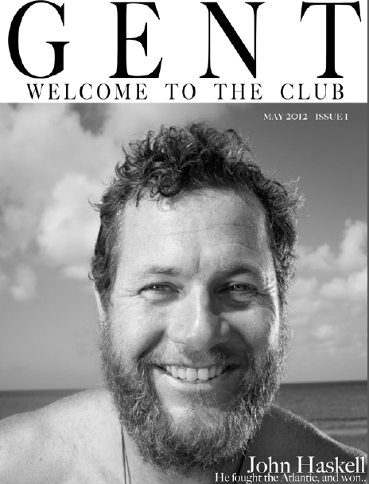

Slide 3
Allocating roles
Editor: Dan Lewis
Sub-editor: Huw Hawkins
News editor: Tomas Griffiths
Art editor: Ben James & Henry McGaughey
Sections editor: Joel Thomas
Picture editor: Michael Hicks

Slide 4
Competition
Gap in market for over 50 male magazine
Numerous magazines with similar target audience
Saga Magazine: 631,530
Esquire – 56,583
Uncut – 62,305
Mojo – 87,555
GQ – 120,000
Men’s Health – 221,176

Slide 5
Market research
Sport
Travel
Film & TV
Books
Sport
Motoring
Gadgets
Nudity

Slide 6
Designing the pages
Use of fonts
Gent tab along bottom of each page
Different styles for features
Inclusion of adverts

Slide 7
Subbing work
In-house style
Comprehensively proof-reading
Titles, standfirsts, captions
Grammar & Spelling

Slide 8
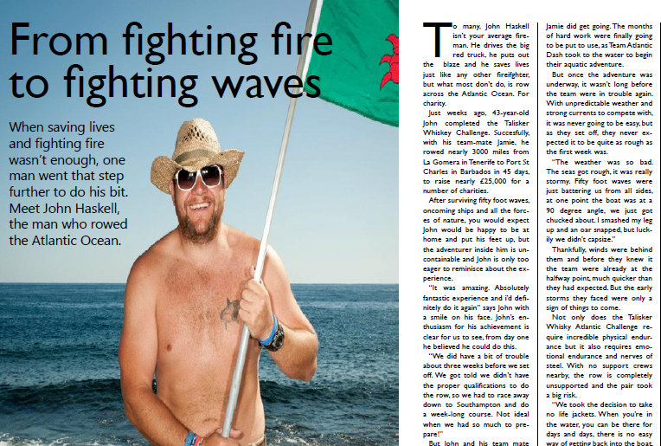
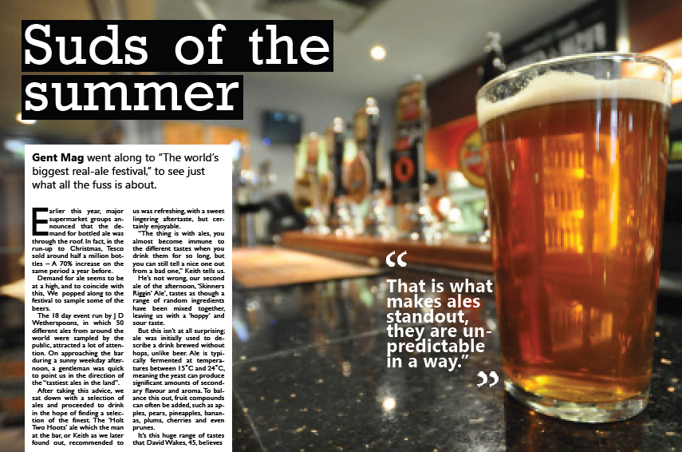
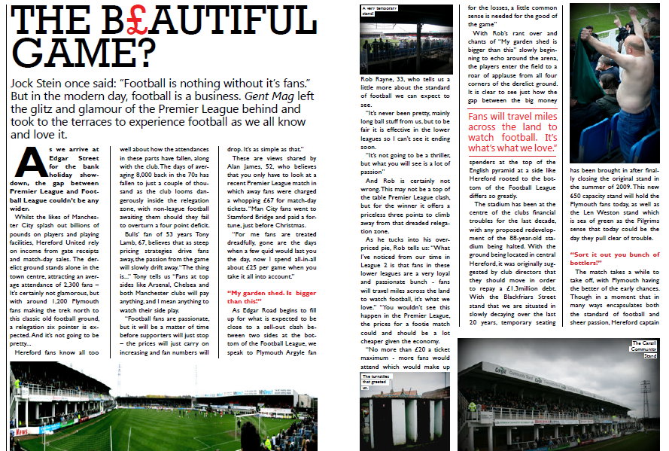
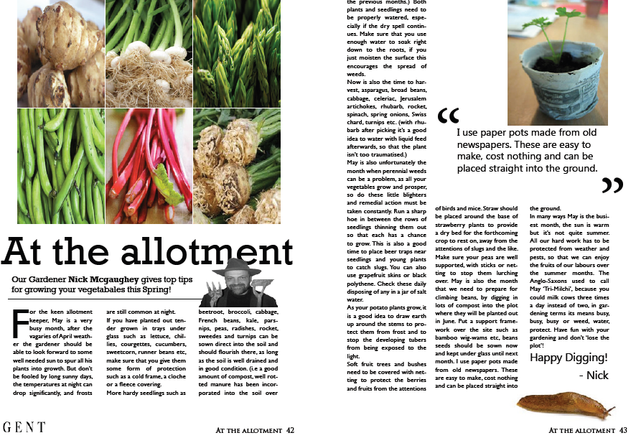
Looking inside the magazine

