Slide 1
Glam Sport
Dan Lewis

Slide 2
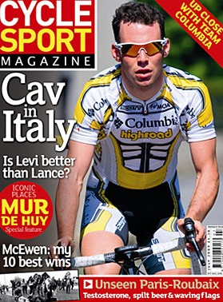
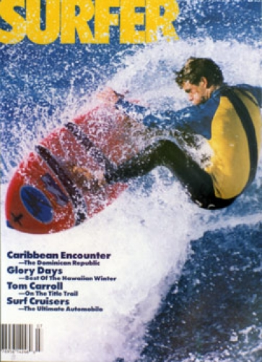
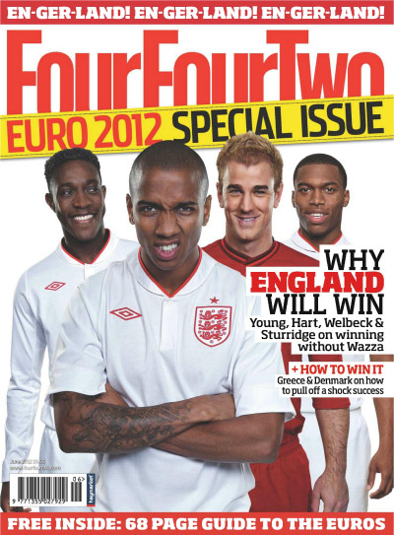
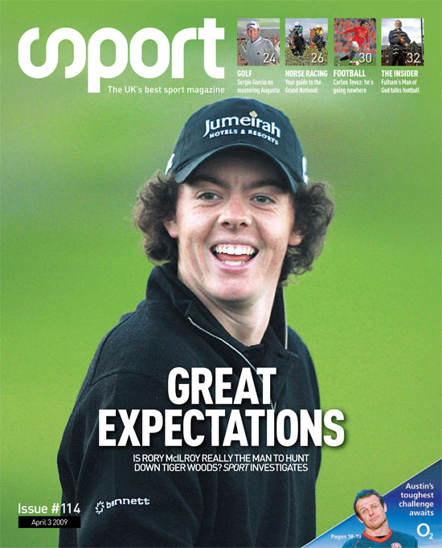
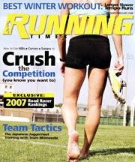
Inspiration

Slide 3
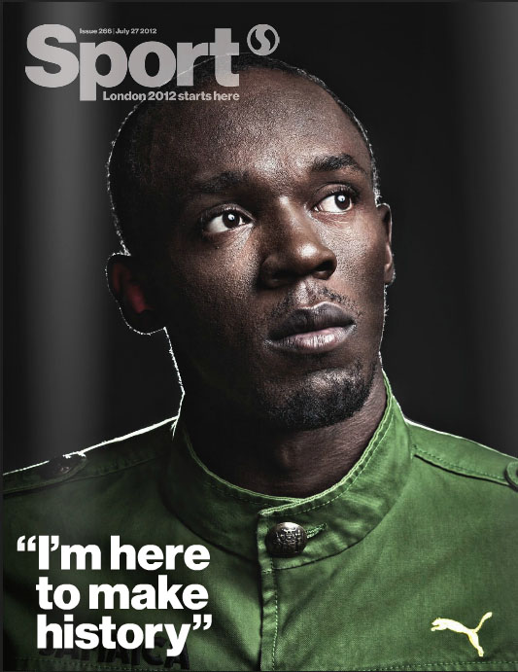
on
Sport
My magazine:
A range of sports, from football through to badminton
Focus solely on University of Glamorgan sport
Aimed at current students at the university, but also past and future students

Slide 4
Sourcing my stories
The Phoenix: Sport Editor
Head of Sport
Team managers/ captains
Different departments (Sport science, ACE, etc)
University PA manager
Photographers
Social Media
Facebook groups – Gaelic football story
Twitter – New Zealand visit Glamorgan story

Slide 5
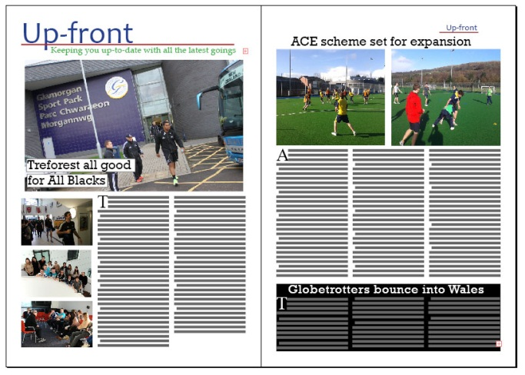
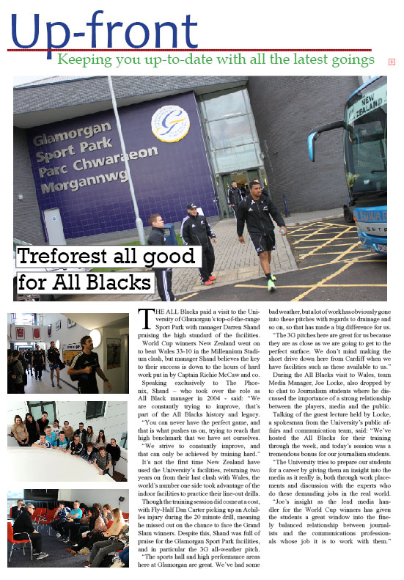
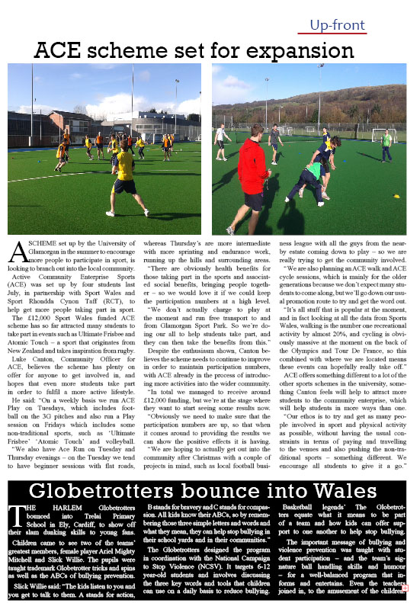
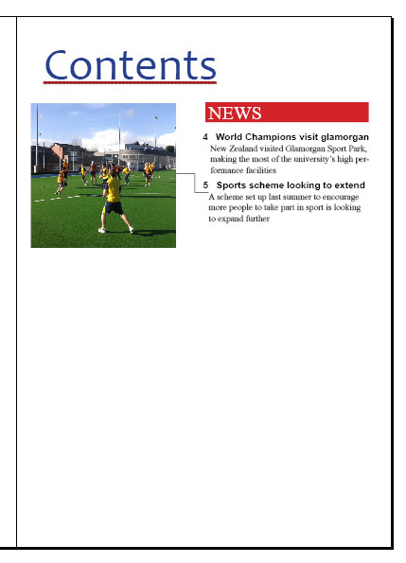
Content

Slide 6
Further content
‘Up-front’ – All the latest news (fixtures & results, news stories, reports)
Big interview – Dan Davies (rugby international), Sam Hobbs (Cardiff Blues/ Glamorgan coach), Jamie Solliss (Paralympian)
Picture section
Comments/ debates – The hot topics in the world of sport (racism, diving, mergers, etc)
Features – Women’s rugby, new sports sides, ‘niche sports’, funding for the uni, proposed merger, sports science, 100 years of Glamorgan Uni…
Coaching/ fitness/ food – Some tips
Back page: ‘Day in life’ (Tudor Williams, kitmen, refs, groundsmen)

Slide 7
Challenges and opportunities
Allows me to combine my two passions of journalism and sport
Better understanding of the design aspect
Improve my abilities as a journalist
Combining a range of sports in one magazine – make sure it’s not all over the place
Challenges getting particular stories, specific sections, etc.

