Slide 1
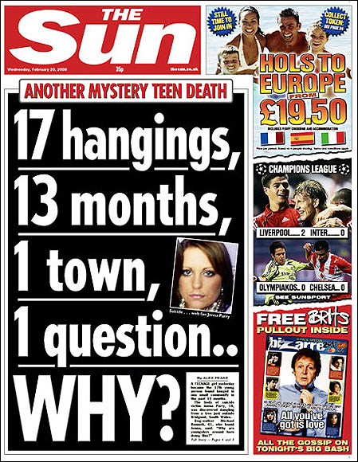
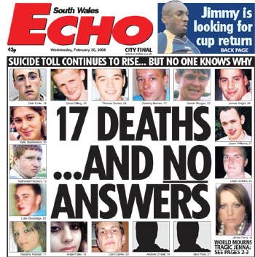
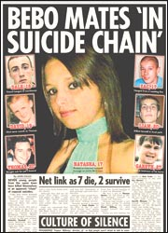
Bridgend suicides: Media reporting & lessons learned
Daniel Lewis & Tomas Griffiths

Slide 2
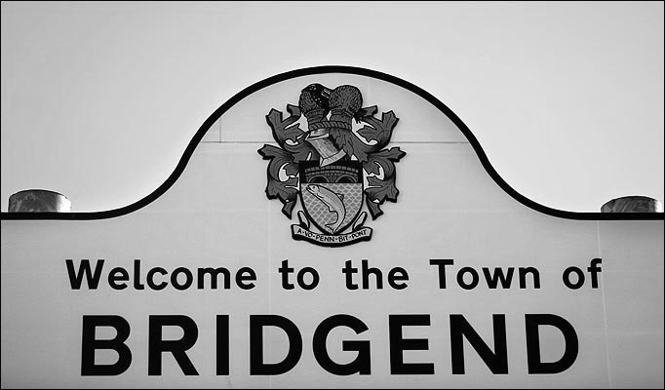
Breakdown of presentation
- About the Bridgend suicides
- Media reporting
- PCC guidelines
- Lessons learned
- Case study 1
- Case study 2
- Questions

Slide 3
http://www.youtube.com/watch?v=Ora1Rnh9hbA
http://www.bridgendthemovie.com/trailer.php

Slide 4
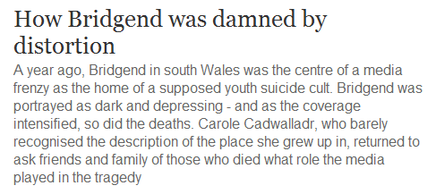
About the Bridgend suicides
Bridgend is a town in South Wales with around 39,000 inhabitants.
Hard to pin down the exact number of suicide victims, but between January 2007 – February 2009 a large amount of people took their own lives:
- BBC reported “more than 20”
- Some newspapers believe the actual figure to be over the 30 mark
- People magazine claim that there has been a total of 79 deaths
The majority of the suicide victims were youngsters, aged between 13 and 17 years old.
Between 1996 and 2006, an average of three men committed suicide in Bridgend every year. In 2007, the average was believed to be around nine.
In 2010, police asked the media to stop covering the suicides in an attempt to prevent ‘copy-cats’ – But had the damage already been done? And have lessons been learned in the aftermath of the Bridgend suicides?

Slide 5
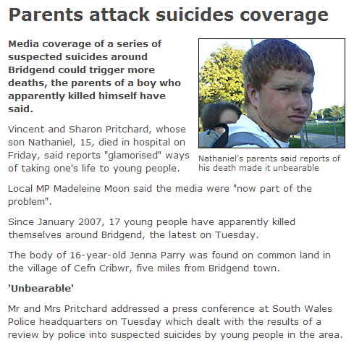
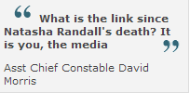
Media reporting
Friends and relatives linked the deaths to the media, believing that because it was glamorised, many more youngsters were made aware of taking their own life.
Dave Morris:
“The media reporting is influencing young people in the Bridgend area. I have noticed an increase in sensationalist reporting, and the fact that Bridgend is becoming stigmatised. The link between the deaths isn't the internet – it is the way the media is reporting the news.”
Sharon Pritchard: “the media were glamorising ways of taking one’s life to young people.”
Madeleine Moon: “the media are part of the problem, and should now be part of the solution”
Sir Christopher Meyer:
“We are ourselves monitoring the situation. But we would urge anyone with examples of articles which in their view are either insensitive or which provide such excessive detail to contact us immediately."

Slide 6
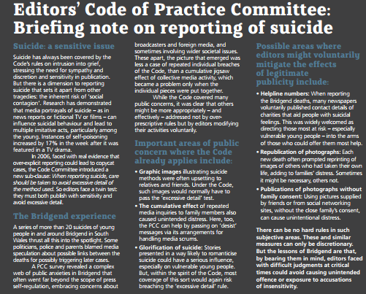
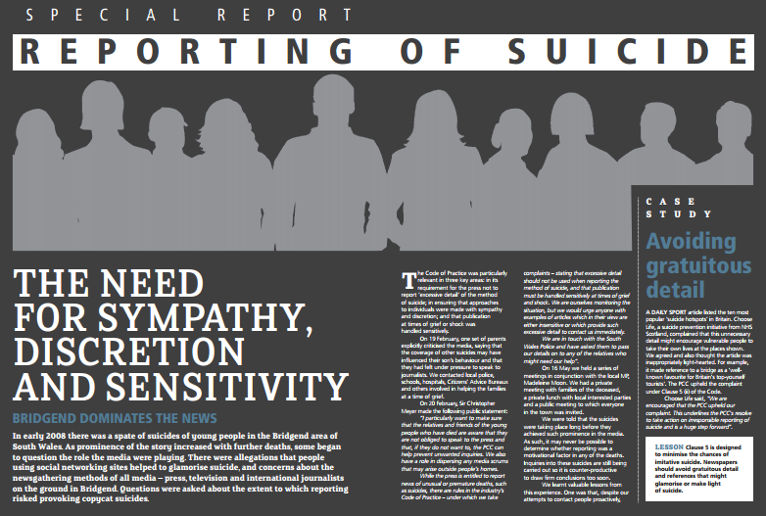
- Press Complaints Commission
Suicide is something that has always been covered by the Code’s rules on intrusion into grief, stressing the need for sympathy and discretion and sensitivity in publication.
Research has shown that media portrayals of suicide – as in news articles, fictional TV or films – can influence suicidal behaviour and lead to multiple acts, particularly among the young.
When reporting on suicide: care should be taken to avoid excessive detail of the method used. Editors must ensure that they both publish with sensitivity and they avoid excessive detail. (Unlike The Sunday Times in 2008 – pictures of a noose with methods).

Slide 7
PCC – ‘The Bridgend Experience’
Important areas of public concern include:
-Graphic images: illustrating suicide methods which were upsetting to family members and friends
-The cumulative effect :Repeated media inquiries to family members also caused unintended distress
-Glorification of suicide: Stories presented in a way likely to romanticise suicide could have a serious influence, especially on vulnerable young people
To mitigate the effects of legitimate publicity, editors might voluntarily include:
-Helpline numbers : to direct those in need of help into the arms of those who could offer them the most support
-Re-publication of photographs : Each new death often prompted reprinting of images of others who had taken their own life, adding to the distress of the families. It was important to try to avoid this, thus not distressing the families further.
-Publication of photographs without family consent : media publications tend to use pictures supplied by friends or from social networking sites, without the families own consent, which, if avoided, would reduce the chances of causing unintentional distress.

Slide 8
Further lessons learned - PCC
Newspapers should avoid gratuitous detail and references that might glamorise or make light of suicide
Newspapers should be aware that the use of photographs, especially when accompanied by dramatic graphics, can cause considerable distress to families
Care must be taken to remove excessive information prior to publication - both online and offline
It is the editor's responsibility to remove excessive detail about how the suicide was carried out

Slide 9
Madeline Moon
"Steps are being taken in the right direction. I was disappointed by much of the coverage of the suicides in the Bridgend area last year. Over that time I have been calling for increased awareness among editors of the hurt caused by repeated use of pictures, excessive details used, and the danger of glorifying suicide and thus the possible social contagion.
"While I would like to see further changes made, I am happy that the print media and the Press Complaints Commission have learned many lessons over the past year. I would ask that editors heed the advice of the new codebook and take a moment to ensure that articles do not include speculation, intrusion or inaccuracy. You don't get speculation over general health issues and therefore it is right not to expect speculation over mental health issues, including those tragic incidences of suicide."

Slide 10
Editors faced with difficult judgements at critical times should avoid causing unintended offence or exposure to accusations of insensitivity – PCC, March 2009.
The PCC make clear in its ruling on the Choose Life VS Daily Sport complaint that "the Code does not seek to prevent a newspaper reporting on the general subject of suicide, or investigating a pattern of suicides, in a manner that serves the public interest."
...though in this particular case, The PCC censured Daily Sport for “glamorising suicide” after the newspaper published an article entitled "Top yourself tourism“ – listing Britain’s top suicide hotspots.

Slide 11
PCC Editors’ Code of Practice- (5) Intrusion into grief or shock
i) In cases involving personal grief or shock, enquiries and approaches must be made with sympathy and discretion and publication handled sensitively. This should not restrict the right to report legal proceedings, such as inquests.
ii) When reporting suicide, care should be taken to avoid excessive detail about the method used.

Slide 12
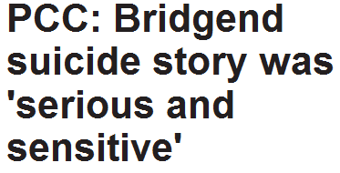
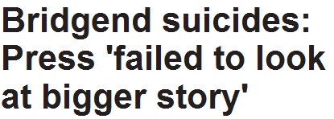
Case Studies – Lessons learned?

Slide 13
Case study 1 – Jacintha Saldanha
Lorna Fraser, the Samaritan's media adviser on the reporting of suicide, said coverage of Saldanha's death so far had been "fairly responsible" – but warned that the mass coverage could have a detrimental impact on vulnerable people.
"It's such a high-profile case that there's a great risk of the media going out and focusing on the detail [of the suicide],"
"In such a high-profile case with such a wide-ranging audience care needs to be taken to be reporting around the means of death because there will be vulnerable audiences involved. The cumulative effect of such mass coverage is a risk in terms of potential copycat behavior."

Slide 14
Samaritans’ media briefing: Reporting on the death of nurse Jacintha Saldanha
Avoid explicit details of the suicide method e.g. do not state where and how an individual took their own life or what material was used (ideally, don’t report the method of suicide at all).
Do not portray a suicide quick, effective, painless or easy.
Do not disclose the contents of any suicide note.
Suicide is complex and seldom the result of a single factor, it is likely to have several inter-related causes.
Remember that family, friends and colleagues who have been bereaved by suicide can be particularly affected by the reporting, as it may exacerbate their feelings of distress.
Avoid the placement of stories on the front page or in large headlines to guard against sensationalising the story.
Avoid presenting suicide as an appropriate way to cope with emotional crisis; it is an extreme and irreversible action.
Where possible sensitively focus on the life achievements of the person and the wastefulness of their death.
We would be grateful if you could include details of our helpline service
We would also like to remind the media that both Ofcom and the PCC have clauses specifically relating to suicide reporting – a requirement that continues to apply when reporting on inquests.

Slide 15
Case study 2 – Gary Speed
“When reporting suicide, care should be taken to avoid excessive detail about the method used.”
The natural response from journalists is to find out exactly why he had taken his own life, though unlike with suicide reporting in the past, things seemed to be done differently.
While the public jumped on numerous bandwagons questioning – guessing – why he had committed suicide, the press instead decided to stick to the facts, being fully aware of the guidelines set out by the PCC.
the press were reporting the method the former Wales manager had used to end his life, but didn’t go into unnecessary detail. The press had rightfully respected the PCC guidelines and showed that they had learned lessons in arguably the biggest suicide story since the outbreak of the Bridgend suicides.

Slide 16
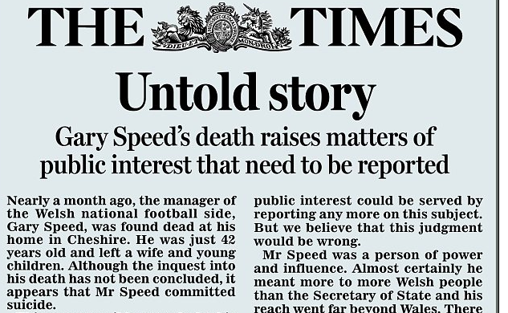
“Mr Speed has been smeared, not by the Press but in its absence” – The Times
“The problem is that we are seeing a chilling effect on the Press and the rest of the respectable media, leaving a large field clear to the unregulated internet and social media so people can peddle lots of things that are not true” – MP Phillip Davies
“Some newspapers failing to make the public interest case for their stories” has led to a situation where the press can no longer report on suicides in any detail.
The correct balance must be found between serving the public interest, but not crossing into the intrusion of grief or shock.
“It is critical that we do not live in a society where rumour takes the place of reporting, and misinformation triumphs over the truth.”
Lessons have most certainly been learned, but whether or not that is a good thing is a different matter.

Slide 17
Any questions?
Some tips for journalists when reporting on suicides - Samaritans
Avoid explicit or technical details of suicide in reports.
Avoid simplistic explanations for suicide
Avoid brushing over the realities of a suicide
Avoid disclosing the contents of any suicide note
Discourage the use of permanent memorials
Avoid labelling places as suicide ‘hotspots’
Don't overemphasise the ‘positive’ results of a person's suicide
Encourage public understanding of the complexity of suicide
Expose the common myths about suicide
Consider the timing
Don’t romanticise suicide or make events surrounding it sound melodramatic
Include details of further sources of information and advice
Remember the effect on survivors of suicide – either those who have attempted it or who have been bereaved
Look after yourself
Use phrases like:
A suicide
Die by suicide
Take one’s own life
A suicide attempt
A completed suicide
Person at risk of suicide
Help prevent suicide
Avoid phrases like:
A successful suicide attempt
An unsuccessful suicide attempt
Commit suicide (Suicide is now decriminalised so use ‘take one's life’, or ‘die by suicide ’instead)
Suicide victim
Just a cry for help
Suicide-prone person
Stop the spread / epidemic of suicide.
Suicide ‘tourist’

